Slide 1
Public Relations in Sub-Saharan Africa
Hannah Charlton & Lindsay Harant

Slide 2
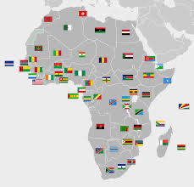
Presentation Overview
Background History
Business Norms
Ghana
Kenya
Nigeria
Religion
Media & Technology
Political Corruption
Corruption in Nonprofits
Food Crisis
Garbage Crisis
Cape Town Water Crisis

Slide 3
Background History
By 1980, most Sub-Saharan African countries had managed to become independent
Africa has the second fastest growing economy in the world
Increased prices on oil, minerals, telecommunications and manufacturing is encouraging this growth
Currently, Africa’s population is 1 billion people
  It’s expected to double by 2030
60% of Africans are illiterate
Radio is one of the most popular forms of information gathering

Slide 4
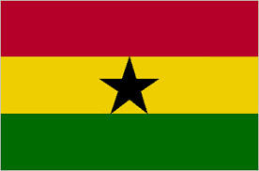
Ghana
Ghana was the first Sub-Saharan Africa country to become independent
  They gained their independence from Britain in 1957
Ghana is very diverse
  Though their main language is English, it is home to a wide variety of ethnicities
Before 1995, their public relations efforts targeted government and public officials
  Today, they work to expose faults within the system and to hold people accountable for their actions
In 2001, a law was passed that states that only members of the Institute of Public Relations, Ghana (IPR) may practice PR in the country
IPR’s vision is to “promote a forward-looking PR body for enhanced stakeholder value”

Slide 5
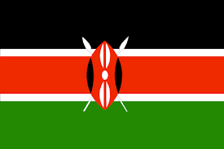
Kenya
According to Alaimo, you must “be prepared to adopt different strategies for the country’s many diverse communities” if you want to practice PR in Kenya
Kenyans are very friendly, and working with them is like working with a good friend
A major PR focus for them is their tourism
Television sets are few and far between in Kenya
  Most people rely on the radio to gather their information
Kenya has its own PR society - the Public Relations Society of Kenya
  It was established in 1971
  Their objective is to “advance excellence” in PR

Slide 6

Nigeria
Political talk is extremely common in Nigeria
  Their radio and television programs are chock full of political content
If you want to work in PR in Nigeria, you better “be prepared to pitch the print press”
Though they are more open to opinion now, many writers and journalists still feel a sense of self-censorship
  They are still very weary of what they say, to who, and on which platform
Though Nigeria is one of Sub-Saharan Africa’s most well-known and prominent places, 62% of the population is living in extreme poverty
Nigerian PR focuses greatly on corporate social responsibility
  They also greatly value oral communication

Slide 7
Business Norms
When greeting one another, both parties usually engage in a formal handshake
  Their greetings are also not short - they would prefer to have a conversation with you than to simply get down to business
Bringing small gifts with you is greatly appreciated
  Especially if it’s a gift for a child
  Gifts should always be wrapped, should never be handed over with your left hand, and should not contain alcohol
When conducting business within Africa, you should have a contingency plan that includes 2-3 extra years
  You need to build up your relationship with the locals first and gain their trust
  In Africa, time is plentiful and time is money

Slide 8
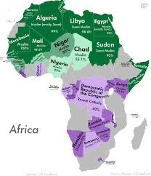
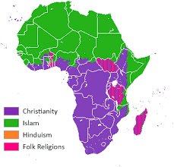
Religion

Slide 9
Media & Technology
Due to high illiteracy rates, PR practitioners need to get crafty with their messages
  Outside of very main and/or central areas, newspaper circulation is rare
  Digital communication blasts have become increasingly popular
Gallup News conducted a survey with people living in Sub-Saharan Africa
  59% of respondents said that they mostly rely on national radio to get their information
Television sets are still fairly expensive for most people living in Africa
  A television set typically costs 10% of their monthly income
Mobile phone use has skyrocketed over the last decade
  The number of people with cellphones has quadrupled over the past 10 years
Still, 400 million people are still without a reliable connection
  About 44% of Africans are part of a mobile subscription; the rest of the world has a 66% average

Slide 10
Political Corruption
Much evidence suggests that political corruption is more prevalent in Africa than anywhere else
Due to colonization, the people of Africa were subject to repressive regimes and political instability
  Despite this, Africa is slowly starting to thrive and conditions are finally beginning to improve

Slide 11
Corruption in Nonprofits
1990’s, nonprofits in the NPOs and SA charity’s are being investigated for fraud and a variety of cyber crimes
“democratization and liberalization have supplied fresh incentives and opportunities for venal politicians and officials. And even among Africa’s more capable resourceful states, the institutional fluidity generated by democratic transition and economic reform has opened up possibilities of systematically organized state capture” (Lodge, T., 2019)
he was called out to investigate fraudulent activity at a global NPO with operations in jurisdictions across Africa. He assesses, “my fraud risk revealed that corruption had cost the organisation R8.5m” (Loxton, 2019). He was once asked to investigate donations of vehicles and equipment at a high-profile SA children’s charity, where none of the cars or computers actually made it to the charity’s head office. He came to the conclusion that they were at senior employees homes and were being used by them and other employees for school runs and shopping trips.

Slide 12
Food Crisis
In the 1980s, it came to light that many parts of Sub-Saharan Africa were in a bad spot when it came to their food supply
Constant droughts and then an over abundance of rain ruined many crops
In 1983, crops were down by 1.2 million tons from the year before (1982) and by 3 million tons from the year before that (1981)
Africa’s ever growing population also did not help the food supply shortage
  Many households stockpiled food for following years, just in case something were to happen within the environment

Slide 13
Garbage Crisis
Starting in 1992, trucks from across the surrounding countries would travel to the coastline in Lagos to the 100-acre Olusosun dumpsite
Due to the massive scale the crisis has gotten to, they have had two outbreaks of Lassa fever, a sometimes deadly virus which can be spread by rodent urine or feces which has been linked to poor sanitation.
One community in Bariga agreed to allow garbage collectors to use their neighbourhood as a dumpsite (Sieff, 2017). They decided to then lay sawdust on top of the garbage and have since started building homes on top

Slide 14
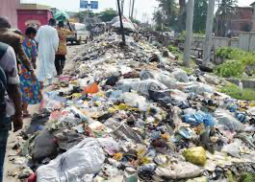
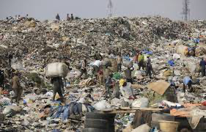
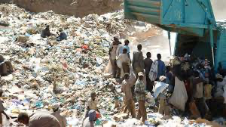
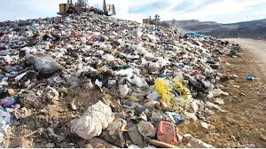
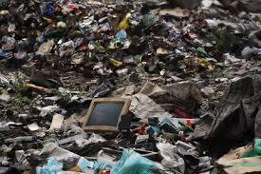
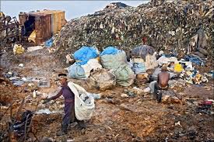
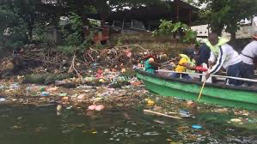
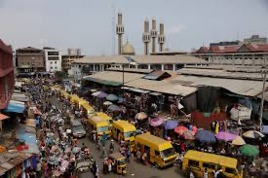
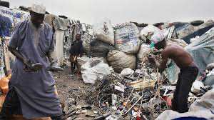

Slide 15
Cape Town Water Crisis
In 2015, water levels in the Western Cape were at dangerously low levels
  However, it wasn’t until mid-2017 that African officials finally took charge of the situation
The general population were put on water restrictions that lasted until 2018
African officials were worried that they would have to implement “Day Zero”
  Day Zero: refers to the day that complete water shut offs occur in a desperate bid to conserve what they had left
  Day Zero was a very real possibility - especially considering the residents of Cape Town refused to limit the amount of water they used each day
  Officials wanted each household to be limited to 25 liters per day

Slide 16
Cape Town Water Crisis Cont’d
Thankfully, in September 2018, water levels were restored to 70% due to conservation efforts
  However, that isn’t to say that there weren’t consequences
  Economy wise, the Western Cape lost a lot of money in tourism due to their vineyards drying up - the Western Cape is well known for their wine
  It led to negative health effects, especially in children and the elderly
  Food crops died
  Many jobs were lost

Slide 17
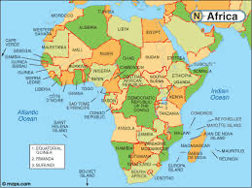
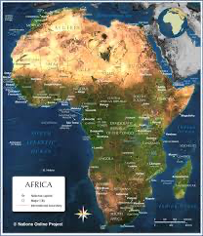
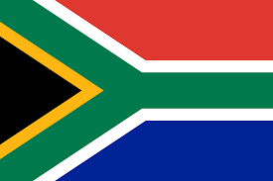
Questions?

