Slide 1
Discrimination
Sasha, Lindsay, Hannah

Slide 2
Table of Contents
Definition of Discrimination
History of Discrimination in Canada
Racial/Ethnic Discrimination
Gender Discrimination
Disability Discrimination
The Equality Act
Workplace Disability Discrimination
AODA
LGBTQ+ Discrimination
LGBTQ+ Military Ban in the U.S.
LGBTQ+ Marriage Rights
LGBTQ+ Blood Donation
LGBTQ+ Bathroom Bans
Discrimination is Everywhere

Slide 3
Define Discrimination
Noun
An act or instance of discriminating, or of making a distinction.
Treatment or consideration of, or making a distinction in favour of or against, a person or thing based on the group, class, or category to which that person of thing belongs rather than on individual merit:
Racial and religious intolerance and discrimination
3. The power of making fine distinctions; discriminating judgment:
She chose the colours with great discrimination
4. Archaic. Something that serves to differentiate.

Slide 4
History of Discrimination in Canada
Began with early settlement but was more visible during the 17th and 18th centuries
Earliest examples of discrimination in Canada are centric to race/ethnicity
Blatant discrimination came to a head in the 19th to mid-20th centuries
The Canadian government was reluctant to accept Black, Chinese, Japanese and South Asian-Canadians from enlisting in both world wars
Ethnic stereotypes at the turn of the century painted immigrants as “poor”, “illiterate”, “morally lax” and “politically corrupt”
Pre-1950s, ethnic slurs were a part of the day-to-day language of Canadians
Racial and ethnic discrimination, as well as discrimination in other forms, still largely exists today

Slide 5
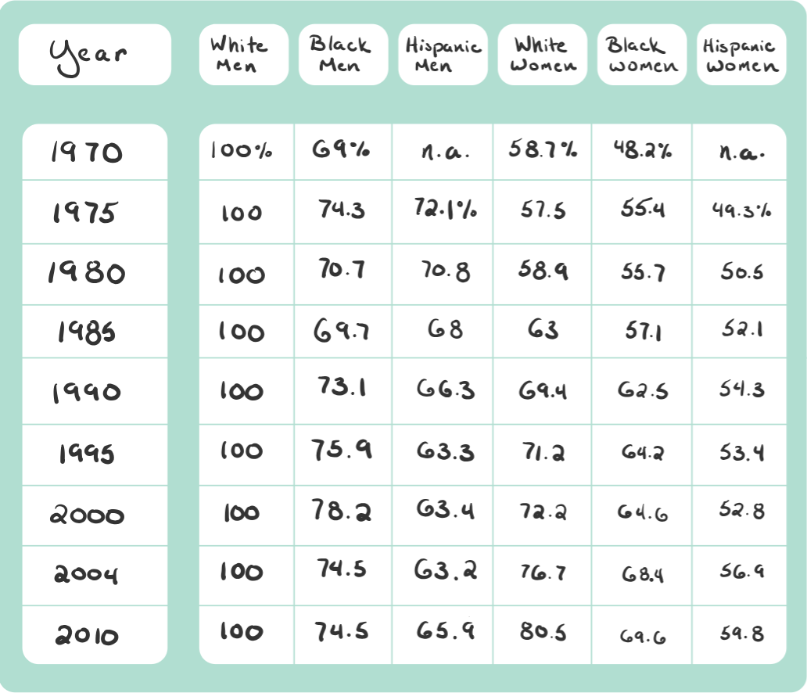
Racial/Ethnic Discrimination

Slide 6
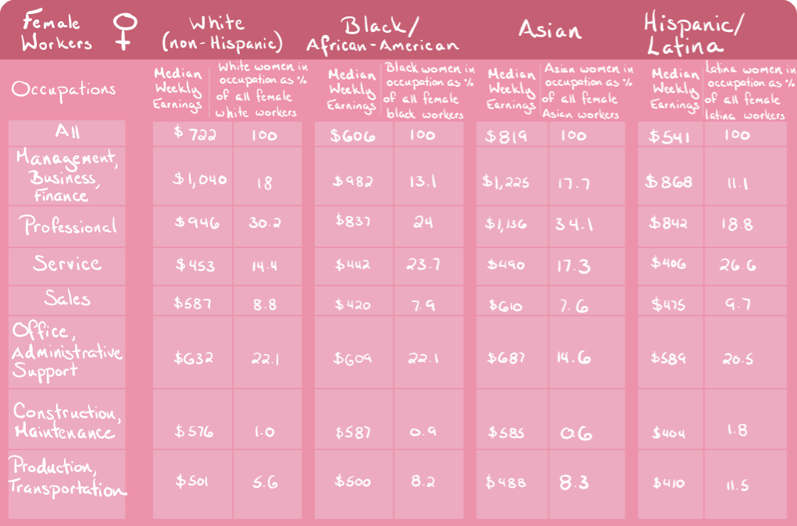
Racial/Ethnic Discrimination

Slide 7
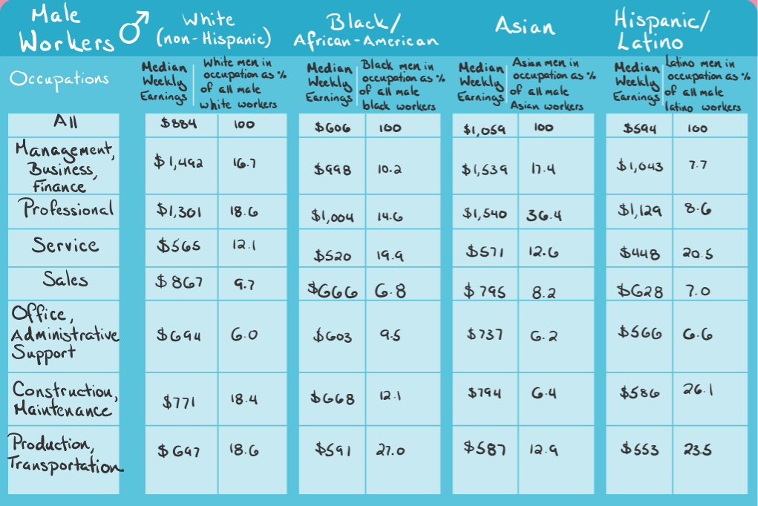
Racial/Ethnic Discrimination

Slide 8
Gender Discrimination
All across the world, women have been the subject to discrimination when it comes to employment, pay, and voting - just to name a few
Up until the 1970s, the British Hong Kong government publicly denied equal pay for equal work for women
  Women living under this government stood to be demoted from “full time” to “part time” employees once married
  Many women ended up losing their jobs
In addition to this, in Canada (among other places) “marriage bars” were set into place between the 19th century and the early 1970s

Slide 9
Gender Discrimination Cont’d
What is a “marriage bar”?
  It was a form of restricting the working conditions of married women
Once a woman married, she was often times subject to being let go from her job
  They will also ineligible of being hired for any positions
  In many instances, this also included widowed women who had children
Nike recently found themselves in hot water with two ex-employees
  Kelly Cahill and Sara Johnston worked for the company in Oregon
  Their lawsuit describes lesser pay, fewer bonuses, and minimal stock options for women
  They also note that women are often overlooked for promotions
Nike admitted to failing to both hire and promote women
  11 executives were ousted
  Raises for 7,000 employees were also then announced

Slide 10

Disability Discrimination
The Canadian Human Rights Act
Prohibits discrimination against persons with disabilities and the Equality Rights Section of the Canadian Charter of Rights and Freedoms guarantees people with disabilities equal benefit and protection before and under the law
Could be a one-off action, a rule or policy or the existence of physical or communication barriers
Does not have to be intentional to be unlawful
6 main types of disability discrimination
  Direct discrimination, indirect discrimination, failure to make reasonable adjustments, discrimination arising from disability, harassment, victimisation

Slide 11

The Equality Act
The Equality Act 2010 - you must not be discriminated against
because:
You have a disability
Someone thinks you have a disability (Discrimination by perception)
You are connected to someone with a disability (discrimination by association)
It is not unlawful discrimination to treat a disabled person more favourably than a non-disabled person

Slide 12

The Equality Act Con.
You are covered by the Equality Act if you have a progressive condition like HIV, cancer or multiple sclerosis, even if you are currently able to carry out normal day to day activities. You are protected as soon as you are diagnosed with a progressive condition.
You are also covered by the Equality Act if you had a disability in the past. For example, if you had a mental health condition in the past which lasted for over 12 months, but you have now recovered, you are still protected from discrimination because of that disability.

Slide 13

Workplace Disability Discrimination
Ministry of Labour - guidelines on how to make the workplace more accessible, accommodations, and supports workers who may have been discriminated due to their disability
Sometimes Unintentional….
  Employers lack of understanding
  Busy workspaces
  Low background noise (office radio)
Sometimes intentional……
  Not making change
  Make unreasonable demands from employee
  Making it difficult to the point where employee quits

Slide 14
AODA
any degree of physical disability, infirmity, malformation or disfigurement that is caused by bodily injury, birth defect or illness and, without limiting the generality of the foregoing, includes diabetes mellitus, epilepsy, a brain injury, any degree of paralysis, amputation, lack of physical co-ordination, blindness or visual impediment, deafness or hearing impairment, muteness or speech impediment, or physical reliance on a guide dog or other animal or on a wheelchair or other remedial appliance or device,
(b) a condition of mental impairment or a developmental disability,
(c) a learning disability, or a dysfunction in one or more of the processes involved in understanding or using symbols or spoken language,
(d) a mental disorder, or
(e) an injury or disability for which benefits were claimed or received under the insurance plan established under the Workplace Safety and Insurance Act, 1997;

Slide 15
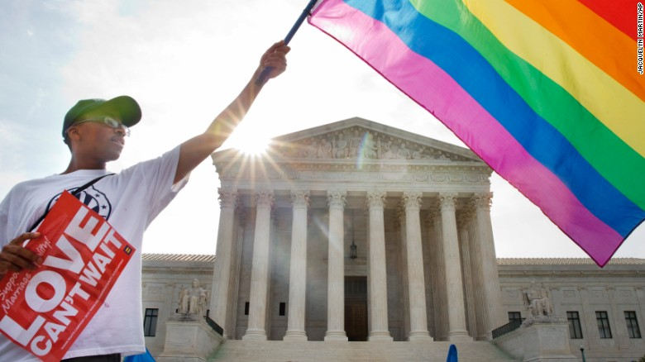
LGBTQ+ Discrimination
Military in the US
Marriage US (same rights as a married couple)
AIDs crisis, blood donation for gay/bisexual men
Bathroom bans (more prominent in US)

Slide 16
LGBTQ+ Military Ban in the U.S
For decades due to outdated and discriminatory medical standards transgender people were prohibited from serving opening in the U.S. military
On June 30, 2016 the Pentagon lifted the ban on transgender people serving openly in the U.S. military, “acknowledging that it is in the military’s best interest to recruit and retain the best troops, regardless of their gender identity”
Transgender service members were able to change their gender in the Pentagon personnel systems and given access to all medical healthcare
No longer able to be discharged due to their gender identity

Slide 17
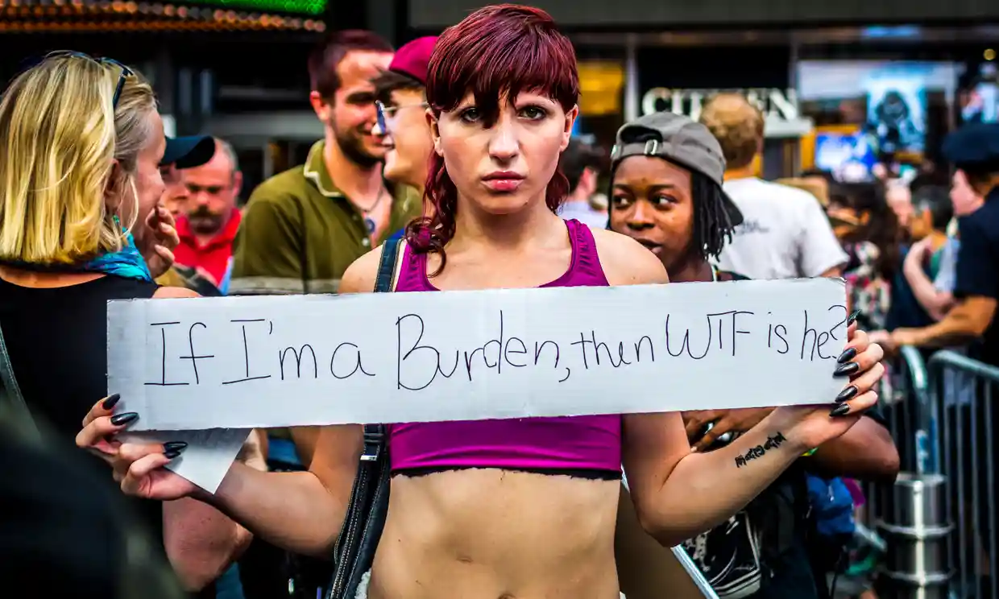
LGBTQ+ Military Ban in the U.S Cont’d
On July 26, 2017 President Donald Trump announced a new ban
https://abcnews.go.com/Politics/video/trump-bans-transgender-service-members-48864271
He was instantly met with revolt from the public
and condemned by more than 56 retired
Generals and Admirals as well as
Members of congress
Multiple lawsuits were filed challenging
Its constitutionality
Despite attempts by the Trump-Pense
Administration, on January 1, 2018 qualified
Transgender people began entering the
Military

Slide 18
LGBTQ+ Marriage Rights
Over the last several years the support for same-sex marriage has increased in the United States
More than 24 countries have laws that allow same-sex marriage (most in Europe and South America)
September 21, 1996- President Bill Clinton sign the Defense of Marriage Act banning federal recognition of same-sex marriage; “a legal union between one man and one woman as husband and wife”
December 3, 1996- Hawaii is the first state to recognize that gay and lesbian couples have the same privileges as heterosexual married couples
May 17, 2004- The first state in the United states legalizes same-sex marriage (Massachusetts)

Slide 19
LGBTQ+ Marriage rights Cont’d
March 30, 2006- Highest court in Massachusetts rules that; Unless same-sex marriage is legal in their own states they are not able to get married in Massachusetts
May 15, 2008- California Supreme Court rules that the state’s ban on same-sex marriage is unconstitutional
June 17, 2009- A memorandum thats grants same benefits to same-sex partners of federal employees is sign by President Barack Obama
August 29, 2013- US Treasury Departments states that even if same-sex couples live in a state that does not recognize same-sex marriage they will be treated as “married” for tax purposes
June 26, 2015- The Supreme Court rules that same-sex couples can marry nationwide in the 5-4 ruling

Slide 20
LGBTQ+ Blood Donation
The Liberal party faced backlash in 2018 when they decided to try to end a ban that excluded sexually active gay men from donating blood
  However, the Liberals election platform from 2015 promised to end this ban - so why did it take so long?
C. Nicholas Cuneo wrote an Op-Ed for the LA Times in 2018
  He highlights the fact that the FDA-approved ban is based on “outdated fear”, rather than facts
  Cuneo states that gay men are not allowed to donate blood unless they have been abstinent for at least 12 months prior to their donation date
Early on in the AIDS epidemic, HIV tests could not detect the virus until 6-12 weeks after an individual had come into contact with the virus
  Today, however, HIV can be detected with near certainty 9-14 days after exposure

Slide 21
LGBTQ+ Bathroom Bans
The argument over transgender bathroom rights came to a head in 2016
  Mississippi and North Carolina passed legislation restricting access to them
Arkansas passed a law in 2015 that states that there are no bans against discriminating against people for their preferred gender identity
  Tennessee passed a similar law in 2011
North Carolina passed a bill that says that individuals are prohibited from using bathrooms that “do not correspond to their biological sex”
In October of 2018, it was announced that Donald Trump’s administration was hoping to pass a new anti-LGBTQ+ policy that would ultimately “define sex as either male or female, unchangeable, and determined by the genitals that a person is born with”

Slide 22
Discrimination is Everywhere
The Association of the Deaf took Netflix to court to provide Closed Captioning and subtitles on content – 2012
A legally blind man could not interact with other parents because he couldn’t read the newsletters
Earlier this month, UPS agreed to pay $2 million to resolve a nationwide disability discrimination lawsuit filed by the EEOC. The federal enforcement agency claimed the employer failed to provide reasonable accommodation for employees with disabilities and fired employees automatically when they exhausted the employer’s 12-month leave maximum.

Slide 23
Questions or Comments?

Slide 24
References
https://www.dictionary.com/browse/discrimination
https://www.thecanadianencyclopedia.ca/en/article/prejudice-and-discrimination
https://www.cnbc.com/2018/08/10/ex-nike-employees-sue-over-gender-discrimination-hostile-workplace.html
https://en.wikipedia.org/wiki/Marriage_bar
https://en.wikipedia.org/wiki/Women%27s_rights#Equal_employment
https://www.thecanadianencyclopedia.ca/en/article/prejudice-and-discrimination
https://www.equalityhumanrights.com/en/advice-and-guidance/disability-discrimination
https://www.khanacademy.org/test-prep/mcat/individuals-and-society/discrimination/a/examples-of-discrimination-in-society-today

Slide 25
References Cont’d
https://www.hrc.org/resources/transgender-military-service
https://abcnews.go.com/Politics/video/trump-bans-transgender-service-members-48864271
https://www.theguardian.com/us-news/2018/mar/23/donald-trump-transgender-military-ban-white-house-memo
https://www.cnn.com/2016/08/23/us/transgender-bathroom-policies/index.html
https://www.vox.com/policy-and-politics/2018/10/22/18007978/trump-administration-lgbtq-transgender-discrimination-civil-rights
https://www.cbc.ca/news/politics/liberal-blood-ban-gay-men-1.4608769
https://www.latimes.com/opinion/op-ed/la-oe-cuneo-gay-blood-donor-20180705-story.html
https://www.cnn.com/2013/05/28/us/same-sex-marriage-fast-facts/index.html

